Slide 1
Community Outbreak of HIV Infection Linked to Injection Drug Use of Oxymorphone — Indiana, 2015
Joan M. Duwve, MD, MPH
Associate Dean for Public Health Practice, Indiana University Richard M. Fairbanks School of Public Health
Chief Medical Officer, Indiana State Department of Health
National Center for HIV,/AIDS, Viral Hepatitis, TB and STD Prevention
Division of HIV/AIDS Prevention

Slide 2
Disclosures
Neither I now Dr. Duwve has any actual or potential conflicts of interest in relation to this program/presentation

Slide 3
Indiana HIV Outbreak Overview
In late 2014, 3 new HIV diagnoses in Austin IN
Only 5 HIV infections had been reported 2004-2013
Of new infections, DIS learned 2 had shared needles by mid-January 2015
8 more new infections diagnosed by 23-January-2015 through contact tracing of needle-sharing partners
Source of infection: injection of the opioid oxymorphone
Notes:
DIS learned in mid-January that 3 had a shared contact and 2 had shared needles.
8 more new infections identified by January 23rd.

Slide 4
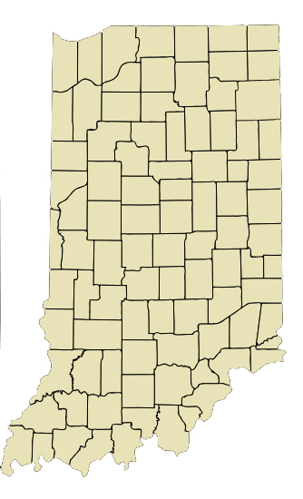
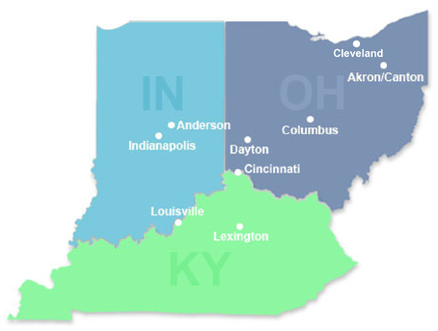
Indiana HIV outbreak: geographic distribution Scott County pop. 24,000; Austin, IN pop. 4,200
Scott County: Among the state’s 92 counties, ranked 92nd in a variety of health and
social indicators, including life expectancy

Slide 5
Indiana HIV Outbreak Overview
27-February-2015: State alerts CDC
9-March 2015: CDC support requested
Epidemiology: characterize outbreak, prevent new infections
DIS: rapid large contact tracing effort
18-March 2015: media campaign initiated, blanket mailer with testing locations sent to all Scott County households
26-March 2015: governor declared public health emergency
Allowed rapid establishment of syringe service program (SSP)
As of 14-June 2015: 170 new HIV infections diagnosed
All epidemiologically linked to Austin IN
Infections were recent and from a single strain of HIV
Notes:
March 18 – media campaign launched You Are Not Alone featuring following messages: treatment, testing, safe sex, don’t abue drugs/don’t share needles. Newspapers, billboards, TV, radio, social media.
Blanket mailer sent to all Scott County households about testing locations,

Slide 6
Demographics of HIV-infected cases (N=135)
Median age 32 years, range 18-57
55% male
100% non-Hispanic white
Of 112 interviewed, 108 (96%) injected drugs
All oxymorphone, some methamphetamine and heroin as well
High poverty (19.0%) and unemployment (8.9%)
Low educational attainment (21.3% no high school)
High proportion without health insurance
Early Release, MMWR Morb Mortal Wkly Report 2015, April 24, 2015; U.S. Census http://quickfacts.census.gov/qfd/states/18/18143.html
Notes:
Oxycodone, methadone also injected. Oxycodone was preferred drug prior to formulary change, see: http://www.sccease.org/2012/05/opioid-addiction-in-scott-county-by-dr-shane-avery-and-lori-croasdell/

Slide 7
Drug Use among of HIV-infected cases (N=108)
Multigenerational
Sharing of injection equipment common
Daily injections: 4-15
Number of partners: 1-6 per injection event
Early Release, MMWR Morb Mortal Wkly Report 2015, April 24, 2015

Slide 8
Cumulative HIV infections diagnosed, Scott County, Indiana through June 14, 2015 (n=170)
Adult prevalence as of Jun-14-2015
Scott County (14,559): 1.1%
Austin (2,841), 80% cases: 4.8 %
Public health emergency declared
Federal
support
requested
MMWR and HAN issued
Local incident command established
Over 28,000 cumulative syringes dispensed
Cumulative case count
Syringe exchange started
Cluster
identified
Initial
diagnosis
Local HIV clinic opened
HIV testing staff & DIS deployed
Notes:
In terms of response time - some considerations....first few cases were not linked until mid-January. One DIS working the cases - and all STD cases, too. Reporting procedures are onerous - HIV reporting is treated differently than all other infectious disease reporting. Information is still considered more sensitive, more protected, so reporting is delayed. At end of January, number of cases/contacts mushroomed and became very rapidly unmanageable. Siloed databases made it difficult to review cases comprehensively. Lack of resources on the ground - building the system from the ground up. Laws didn't initially support syringe exchange - and there was resistance at the local level as well - lots of layers of response needed.

Slide 9
Contact Tracing - Methods
Elicited information about partners in the past 12 months
Needle-sharing, sexual, social (could benefit from an HIV test)
HIV testing was offered to all contacts who could be located
Point-of-care rapid tests with simultaneous venous blood draw
HIV-positive persons were referred to case coordination and antiretroviral treatment (by mid-April, case coordinators accompanied DIS to field)
HIV-negative person who injected drugs
Informed about syringe service program and PrEP
Offered assistance with substance use disorder services
Recommended to undergo repeat HIV testing
All person tested for HIV were also tested for HCV
Notes:
Imid-April, Case coordinators began going with DIS to do case investigations to expedite entry into care
All persons tested for HIV were also tested for HepC, HepB, and syphilis

Slide 10
Hepatitis C Infection
Convenience sample of specimens tested from high-risk persons (e.g., injection-equipment sharing or sexual partners)
HIV-infected → 95% HCV co-infected
At-risk persons → est. 60% HCV monoinfected

Slide 11
Contact Tracing – Results as of June 14, 2015
Named contacts elicited by DIS from HIV-infected persons: 493
411 (83%) located, assessed for HIV risk, and tested for HIV/HCV
Several “not tested” have later been screened at county jail
43% HIV positivity among needle-sharing and sexual contacts
Number of contacts named in past 14 days was 7 but number of contacts named who were new was 0
With plateauing case count, these data suggest network was near saturation
(see poster TUPE026 for details about the contact network analysis)
Notes:
Several unable to locate contacts were identified and tested during routine testing established at county jail.

Slide 12
Challenges Responding to Outbreak
Very few affected persons were employed or insured
Lacked documents to enroll in state-supported program
Little HIV awareness in the general population
Unaware of transmission risks and treatment benefits
No routine education about HIV in schools (abstinence only)
No outpatient HIV/HCV care available in the community
Syringe service program not permitted by state law
Limited addiction services, including medication-assisted therapy
Notes:
Few infected persons employed. Few insured, despite eligibility under HIP 2.0 (Indiana’s medicaid expansion waiver program). Many lacked required documents to sign up for HIP 2.0. Indiana Medicaid implemented presumptive eligibility for this population in order to respond quickly to need for testing and treatment.
A lot of HIV misinformation in the general population: how spread, how infectious, and availability of effective treatment. No routine education about HIV in schools.
No MAT services in this community. Abstinence-based programs are available.

Slide 13
Community Outreach Center with One-Stop Shop
Insurance enrollment (e.g., birth certificates, driver’s license)
Care coordination for HIV medical care
Syringe service program by local health department: fixed location and mobile unit
HIV and HCV testing
Routine immunizations
Job training
Notes:
No substance abuse treatment was available at COC. There was a counselor on-site, but no treatment options on-site. This continues to be a source of frustration. I’d rather give kudos to the immunization services provided – Hep A, Hep B, and Tdap
Please mention Local health department operates Syringe Exchange program – fixed location and mobile unit
Also Hep C testing, Vital records – birth certificates, and BMV – ID cards. Also job training.

Slide 14
Clinic-Based Interventions to Prevent HIV Transmission
Focused support on local family practitioner and the jail
Provided assistance to increase capacity for:
HIV testing
HIV care for infected persons
Medication-assisted therapy for opioid addiction
PrEP
Collaborative effort
Academic clinical partners
State and federal U.S. HIV agencies (DMSA, HRSA, SAMHSA)
Private sector (LifeSpring, AHF)
Community members
Notes:
Local doc now using Vivitrol and Suboxone. Still no behavioral/addiction services accessible in Austin.

Slide 15
Communications

Slide 16
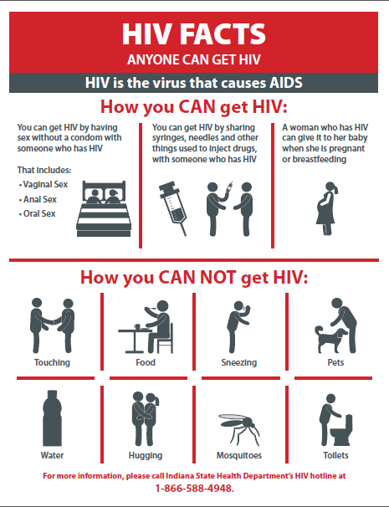
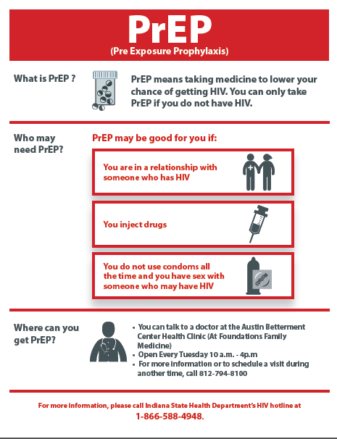
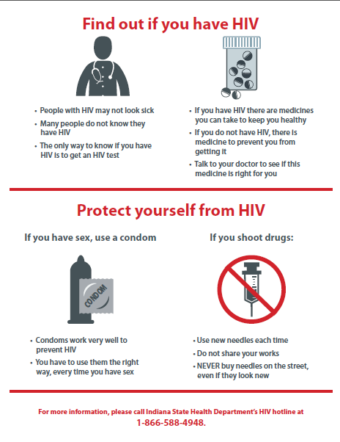
Communications

Slide 17
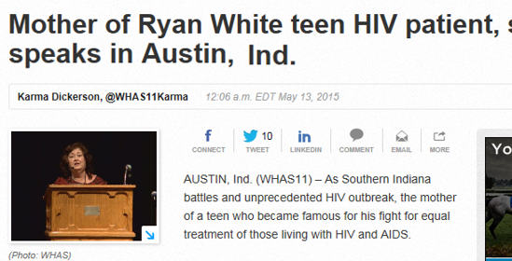
Communications

Slide 18
Controlling the Outbreak
Initiate effective antiretroviral therapy for all HIV-infected
Expand HIV/HCV testing efforts and capacity to detect early signals
Routine HIV testing at venues enriched in high-risk persons (e.g., jails, addiction services, ERs)
Active outreach testing to at-risk population (e.g., PWID)
Develop systems to keep uninfected uninfected
Systematic retesting and education of high-risk persons
Repeat offer and provision of SSP and HIV PrEP
Decrease opioid over-prescribing and increase addiction treatment services
Medication-assisted therapy
Overdose prevention (“lay naloxone” law passed April 2015)
Long-term solutions to improve public health infrastructure and socioeconomic disparities, and to reduce stigma (e.g., HIV, MAT)
Notes:
Testing is also done during syringe exchange –
Naloxone training and kits provided to 66 first responders (police, fire, basic life support)
Indiana State Prescription Drug Abuse Prevention Task Force legislative initiatives have decreased opioid prescribing by 11% from January 2013-December 2014.
Indiana passed lay naloxone provider law in 4/2015.
STIGMA – We have to change the way we talk about addiction and mental health, get the facts out about MAT, and have renewed educational efforts around HIV and Hep C.

Slide 19
Acknowledgements
Indiana State Department of Health (ISDH)
Scott County Health Department
Clark County Health Department
Disease Intervention Specialist Team (multiple organizations)
Foundations Family Medicine
Indiana University, Division of Infectious Diseases
University of Louisville, Division of Infectious Diseases
Division of HIV/AIDS Prevention (DHAP)
Division of Viral Hepatitis (DVH)
Epidemic Intelligence Service (EIS) Program Office
For more information please contact Centers for Disease Control and Prevention
1600 Clifton Road Ne, Atlanta, GA 30333
Telephone: 1-800-CDC-INFO (232-4636) / TTY: 1-888-232-6348
E-mail: cdcinfo@cdc.gov Web: www.cdc.gov

