Slide 1
Table ronde Comorbidités Immunologie et VIH
Impact de la PREP sur la réponse immunitaire VIH-spécifique Pataccini JID 2015
Inflammation / Activation immune sous traitement: impact du nadir CD4+ Hunt JID 2016
Comorbidités chez les PVVIH >65ans et leur coût
Guaraldi et al. ClinicoEconomics and Outcomes Research 2013
Friedman et al. AIDS Accepted

Slide 2
PREP and HIV-specific immune response
Hypothesized mechanism by which PrEP prevents infection = direct antiviral inhibition of HIV replication
PrEP also potentially permit the formation of HIV-specific memory responses, which could augment the antiviral protective effects of PrEP (based on nonhuman challenge studies)
If observed in humans (“chemo-vaccination”): continuation of protection even in the absence of the PrEP medication, as would occur during treatment interruption or cessation.
→ Evaluation of the relationship between exposure to PrEP and HIV-specific T-cell responses and innate responses.
Pattacini, JID 2015
Notes:
The hypothesized mechanism by which PrEP prevents infection is by direct antiviral inhibition of HIV replication, likely at very early stages. However, based on nonhuman challenge studies, PrEP has been hypothesized to also potentially permit the formation of HIV-specific memory responses, which could augment the antiviral protective effects of PrEP, if observed in humans [5, 6]. This phenomenon, which has been described as “chemo-vaccination,” might allow for the continuation of protection even in the absence of the PrEP medication, as would occur during treatment interruption or cessation. In the present study, we performed a comprehensive evaluation of the relationship between exposure to PrEP and HIV-specific T-cell responses and innate responses.We found no evidence to support the hypothesis that PrEP enhances immune responses against HIV.
we observed relatively high rates of HIV-specific T-cell responses, though we hypothesize that this is a result of the high-exposure population selected for Our study shows that there are no statistically significant differences in circulating HIV-specific immune responses in HESN individuals on PrEP versus placebo that are detectable with the current power of the study. However, our results do not exclude the possibility that cell-mediated immunity in genital tissue could be enhanced by PrEP. Furthermore, our study does not take into account proliferative or antibody-mediated immune response in the blood as well as at the site of viral entry. However, based on our extensive study of peripheral blood immunity, we conclude that PrEP does not affect the circulating T-cell or NK cell response to HIV and the results suggest that no synergy should be expected to provide enhanced protection from HIV acquisition through boosting immunity when PrEP is used in concert with candidate HIV vaccines.

Slide 3
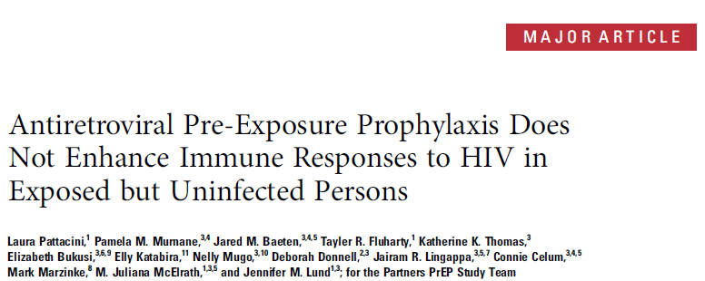
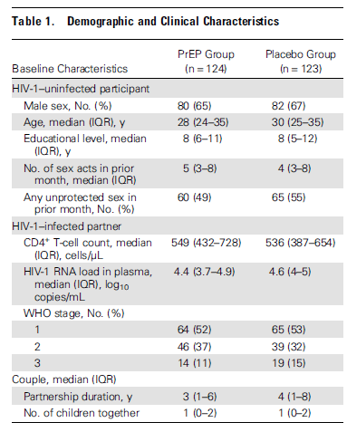
Partners PrEP Study
(randomized, placebo-controlled clinical trial of daily oral PrEP among 4747 HIV-uninfected members of heterosexual HIV-serodiscordant couples from Kenya and Uganda).
Samples from HIV-uninfected partners at M12 after trial enrollment.
PBMCs and autologous serum were obtained from 247 HESN individuals (123 placebo, 124 TDF/FTC PrEP)
HESN: HIV-Exposed SeroNegative
107/120 active arm participants (89%): high adherence to PrEP.
Pattacini, JID 2015
Notes:
PBMCs and autologous serum were obtained from 247 HESN individuals participating in the Partners PrEP Study, a randomized, placebo-controlled clinical trial of daily oral PrEP among 4747 HIV-uninfected members of heterosexual HIV-serodiscordant couples from Kenya and Uganda [3].
Samples were selected from HIV-uninfected partners (half assigned placebo, half assigned tenofovir/emtricitabine PrEP) at a study visit 12 months after trial enrollment.
Additional selection criteria included:
no evidence of HIV acquisition at month 12
receipt of study medication (PrEP or placebo) for all 12 months between enrollment and the month 12 visit
high risk of HIV transmission (anticipated HIV incidence >5% per year), as quantified by a validated composite risk scoring tool for HIV-serodiscordant couples to select for those with highest HIV exposure
identification as HESN persons whose HIV-infected partners had not initiated antiretroviral therapy by the month 12 visit.
PMBCs were stimulated with global potential T-cell epitope peptides for HIV-1 Gag, Env, or Tat, each including the 40 most frequent 15-mer peptides among all sequences the frequency of cytokine responses to Gag, Env, or Tat peptide pools was defined as CD4+ T cells dually expressing interferon(IFN) γ and tumor necrosis factor (TNF) α , and as CD8+ T cells expressing IFN-γ and CD107a after ex vivo stimulation.
Plasma tenofovir concentrations were quantified using an ultraperformance liquid chromatographic-tandem mass spectrometric With a lower limit of quantitation of 0.31 ng/mL. Demographic and clinical characteristics were comparable between those who had received PrEP and those receiving placebo.

Slide 4
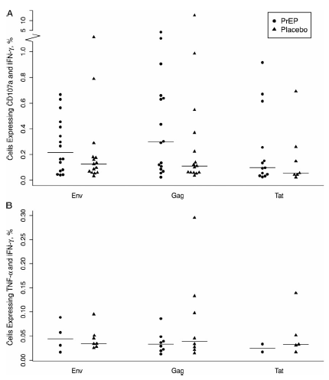
Does PrEP during a period of ongoing HIV exposure induce an immune response that assists in preventing viral spread?
Characterization of the CD8+ T-cell responses to Gag, Env, or Tat peptide pools
(+ response = CD8+ T cells expressing IFN-γ and CD107a or IFN-γ and TNF-α after ex vivo stimulation) in subjects receiving either PrEP or placebo
CD8+
CD4+
→ PrEP does not modify the magnitude of HIV–specific CD8+ and CD4+ T-cell responses.
A, Magnitude of CD8+ T-cell responses: frequency of IFNγ and CD107a dually producing cells.
B, Magnitude of CD4+ T-cell responses: IFN-γ and TNFα dually producing cells.
Cell frequencies for PrEP and placebo groups are shown on stimulation with Env, Gag, and Tat PTE peptide pools.
Pattacini, JID 2015
Notes:
a robust HIV-specific CD8+ Tcell response is thought to be a key component in controlling viremia after acute infection and the maintenance of a low
viral load in a subset of HIV-infected subjects known as “elite controllers”. Therefore, we characterized the CD8+ T-cell responses in subjects receiving either PrEP or placebo to evaluate if PrEP, during a period of ongoing HIV exposure, induces an immune response that assists in preventing viral
spread. Specifically, we measured CD8+ T-cell responses to Gag, Env, or Tat peptide pools and defined a positive response as CD8+ T cells expressing IFN-γ and CD107a or IFN-γ and TNF-α after ex vivo stimulation. The overall frequency of CD8+ T-cell responses detected was 20.0% and 17.4% for PrEP and placebo recipients, respectively, for IFN-γ and CD107a to indicate positivity (P = .53); when IFN-γ and TNF-α were used, 50.4% and 51.3% of individuals, respectively, had an HIV-specific CD8+ T-cell response (P = .73; Table 2).
The frequencies of responses to individual Gag, Env, and Tat pools were similar in PrEP and placebo recipients. If a CD8+ T-cell response was alternatively defined as production of IFN-γ and macrophage inflammatory protein (MIP) 1β, or production of the single markers IFN-γ, TNF-α, MIP-1β, and CD107a, no significant difference was observed between the 2 groups (data not shown).
We next examined the magnitude of the responses by calculating the percentage of cells positive for the measured parameters among responders (as determined by the combined IFN-γ and CD107a positivity criterion). We first confirmed that the difference in response to dimethyl sulfoxide between the 2 arms was not statistically significant. The magnitude of IFN-γ and CD107a double positive responses was comparable in the PrEP and placebo groups; the median responses were 0.30 (interquartile range, 0.10–0.65) and 0.11 (0.06–0.37) in PrEP and placebo recipients, respectively, on ex vivo stimulation with Gag (P = .20), 0.22 (0.08–0.43) and 0.13 (0.06–0.18), respectively, with Env (P = .33), and 0.10 (0.05–0.26) and 0.06 (0.04–0.26),
respectively, with Tat (P = .69) (Figure 1A). We compared the magnitude of the responses for different marker combinations (IFN-γ and TNF-α double positive and IFN-γ and MIP-1β double positive), as well as for single markers, and we did not observe any differences between PrEP and placebo groups (data not shown). Finally, we determined the breadth of the responses by evaluating the number of samples responding to 2 or 3 of the peptide pools tested. We did not detect any difference between PrEP and placebo groups (P = .56; data not shown).
A similar analysis was performed to examine HIV-specific CD4+ T-cell responses in the PrEP compared with placebo recipients. We defined a positive CD4+ T-cell response as dually-producing IFN-γ and TNF-α. Responses recognizing any HIV-peptide pool were detected in 8.7% of PrEP and 9.6% of placebo recipients (P = .62). When responses induced by each peptide pool were examined, we observed the highest frequency of responses to Gag (7.0% for both PrEP and placebo; P = .99), followed by Env (3.7% and 6.3% for PrEP and placebo; P = .37), and Tat (2.2% and 5.5%; P = .24) (Table 2). As for
CD8+ T cells, we compared PrEP and placebo groups for frequencies of CD4+ T cells secreting other cytokine combinations, as well as a single cytokine, and we did not observe any differences (data not shown). We evaluated the magnitude of the CD4+ T-cell responses among responders and did not observe any differences in magnitude (Figure 1B) or breadth (P = .07; data not shown) of any CD4+ T-cell cytokine response measured from PrEP and placebo recipients. In sum, evaluation of HIV-specific T-cell responses in PrEP versus placebo recipients revealed that PrEP does not affect HIV-driven cytokine expression by CD8+ or CD4+ T cells.

Slide 5
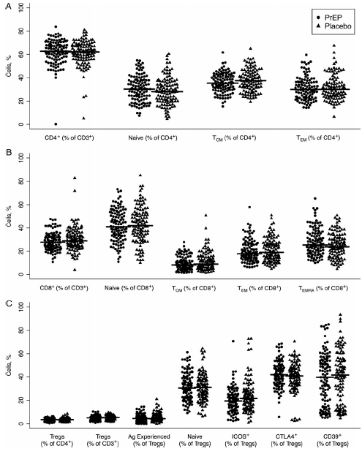
PrEP does not induce changes in CD8+ T cells, nor in conventional or Treg CD4+ T-cells
CD4+
CD8+
Treg
Pattacini, JID 2015
Notes:
Effect of PrEP on Peripheral Blood T-Cell Phenotype- We focused on the frequency of CD4+ T cells and their activation status, a prerequisite for viral replication [21]. Percentages of total CD4+ T cells were comparable in the 2 groups (62.3% in PrEP, 61.0% in placebo; P = .36) (Figure 2A). Chronic activation was defined by quantifying the percentages of Bcl-2loKi67+ T cells, 1.6% of CD4+ T cells in PrEP recipients versus 1.7% of CD4+ T cells in placebo recipients were in a state of chronic activation (P = .60).
Because HIV preferentially infects memory CD4+ T cells [23],we evaluated the effect of PrEP on T-cell maturation by using the markers CCR7 and CD45RA. The frequencies of TN (CCR7+CD45RA+: 30.6% for PrEP and 28.6% for placebo, P = .17), TCM (CCR7+CD45RA−: 35.6% for PrEP and 37.6% for placebo, P = .08), and TEM(CCR7-CD45RA−: 30.9% for PrEP and 31.4% for placebo, P = .76) did not differ in the 2 analyzed groups the phenotype of CD8+ T cells, and we observed a higher percentage of TCM(CD45RA−CCR7+) CD8+ T cells in the placebo group (9.4% and 11.2% in PrEP and placebo, respectively; P = .04). Conversely, the frequency of CD45RA+ effector memory T cells was higher in the PrEP group (11.4% in PrEP and 10.4% in placebo groups, respectively; P = .05
We reported elsewhere that in a subset of HESN individuals, regulatory T-cell (Treg) suppressive capacity in response to HIV is reduced, possibly allowing for a more efficient virus-specific immune response. To determine whether Treg function was altered by PrEP, we quantified Treg frequency from the 2 study arms, together with the known Treg function and activation markers inducible T-cell costimulator ICOS, CD39,CTLA4, and Ki67. No significant differences were observed between PrEP and placebo groups in the frequency of Tregs, nor in their expression of activation or maturation markers. Thus, we conclude that PrEP does not induce changes in CD8+ T cells, nor in conventional or Treg CD4+ T-cells.

Slide 6
Innate and B-cell immune responses are not affected by PrEP.
NK cells: Frequencies of total, cytotoxic (CD56dimCD16+), CK-secreting (CD56hiCD16−), and exhausted (CD56−CD16+) NK cells
B-cell (CD19+), myeloid dendritic cell (mDC; CD11c+), and plasmacytoid dendritic cell (pDC; CD123+)
Pattacini, JID 2015
Notes:
Effect of PrEP on NK Cells and Antigen-Presenting Cells NK cells expand early after HIV infection, control the initial viral replication, and shape the quality of the subsequent adaptive immune response by producing specific cytokines.
We identified NK cell responses based on IFN-γ production and degranulation (CD107a+) in the presence of HIV-peptide pools and autologous serum. We detected a response to ≥1 peptide pools in 12.6% of PrEP and placebo samples. In addition to assessing NK cell cytokine production, we examined the phenotypes of NK cells in PrEP and placebo recipients. NK cells can be divided into 3 subsets [28]: the CD56hiCD16−fraction contains the cytokine-secreting NK cells, CD56dimCD16+cells have cytolytic function and quickly expand after HIVinfection, and CD56−CD16+ NK cells correspond to an exhaustedpool of NK cells, which is characteristic of the late-stage of HIVinfection [29]. PrEP did not affect the distribution of NK cells in these subsets; in fact, the frequencies of NK cells with a cytolytic function (CD56dimCD16+) were 67.5% and 67.6% of total NK cells (P = .97), the cytokine-secreting NK cells (CD56hi) were 3.4% and 3.9% of total NK cells (P = .30), and exhausted NK cells (CD56loCD16+) were 13.5% and 11.5% of total NK cells
(P = .20) in PrEP and placebo groups, respectively (Figure 3A).
Finally, we quantified the CD19+ B-cell frequency in samples from the PrEP and placebo groups and found no significant differences (Figure 3B).
Finally, because DCs are crucial in the initial stages of antiviral immune response generation [30], we quantified plasmacytoid (CD123+) and myeloid (CD11c+ ) DC frequency and activation by measuring the expression of CD40 and CD86. PrEP exposure did not modify DC frequency or activation. Therefore, we demonstrated that PrEP does not modify NK cell subset distribution and phenotype, B-cell frequency, or DC frequency and activation.

Slide 7
CONCLUSION
Evaluation of the relationship between exposure to PrEP and HIV-specific T-cell responses and innate responses.
no evidence to support the hypothesis that PrEP enhances immune responses against HIV.
no statistically significant differences in circulating HIV-specific immune responses in HESN individuals on PrEP versus placebo
Do not exclude the possibility that cell-mediated immunity in genital tissue could be enhanced by PrEP.
Mechanism for PrEP efficacy is due to its antiviral action at the site of entry of the virus → adherence to PrEP is essential for HIV protection.
Pattacini, JID 2015
Notes:
The hypothesized mechanism by which PrEP prevents infection is by direct antiviral inhibition of HIV replication, likely at very early stages. However, based on nonhuman challenge studies, PrEP has been hypothesized to also potentially permit the formation of HIV-specific memory responses, which could augment the antiviral protective effects of PrEP, if observed in humans [5, 6]. This phenomenon, which has been described as “chemo-vaccination,” might allow for the continuation of protection even in the absence of the PrEP medication, as would occur during treatment interruption or cessation. In the present study, we performed a comprehensive evaluation of the relationship between exposure to PrEP and HIV-specific T-cell responses and innate responses.We found no evidence to support the hypothesis that PrEP enhances immune responses against HIV.
we observed relatively high rates of HIV-specific T-cell responses, though we hypothesize that this is a result of the high-exposure population selected for Our study shows that there are no statistically significant differences in circulating HIV-specific immune responses in HESN individuals on PrEP versus placebo that are detectable with the current power of the study. However, our results do not exclude the possibility that cell-mediated immunity in genital tissue could be enhanced by PrEP. Furthermore, our study does not take into account proliferative or antibody-mediated immune response in the blood as well as at the site of viral entry. However, based on our extensive study of peripheral blood immunity, we conclude that PrEP does not affect the circulating T-cell or NK cell response to HIV and the results suggest that no synergy should be expected to provide enhanced protection from HIV acquisition through boosting immunity when PrEP is used in concert with candidate HIV vaccines.

Slide 8
START sub-study
Link between biomarkers of immune activation and end-organ disease during treated HIV infection
Impact of early ART initiation on both immune activation and non–AIDS-related and AIDS-related morbidity
Hunt et al. JID 2016
Notes:
Despite marked improvements in the modern treatment era, human immunodeficiency virus (HIV)–infected individuals, particularly those who initiated antiretroviral therapy (ART) at advanced disease stages, continue to have increased age-related morbidity and mortality, compared with the general population. Immune activation and inflammation persist despite suppressive ART and predict many of these morbidities. The goal of this review is to examine the evidence suggesting a link between the persistent inflammatory state and morbidity and mortality in this setting, to describe the impact of early ART initiation on these factors, and to highlight important unanswered questions for the field. We also advance a hypothesis to explain why some morbidities—and their root inflammatory drivers—may be prevented more than others by early ART initiation.
START
METHODS
We randomly assigned HIV-positive adults who had a CD4+ count of more than 500 cells per cubic millimeter to start antiretroviral therapy immediately (immediate- initiation group) or to defer it until the CD4+ count decreased to 350 cells per cubic millimeter or until the development of the acquired immunodeficiency syndrome (AIDS) or another condition that dictated the use of antiretroviral therapy (deferred-initiation group). The primary composite end point was any serious AIDS-related event, serious non–AIDS-related event, or death from any cause.
RESULTS
A total of 4685 patients were followed for a mean of 3.0 years. At study entry, the median HIV viral load was 12,759 copies per milliliter, and the median CD4+ count was 651 cells per cubic millimeter. On May 15, 2015, on the basis of an interim analysis, the data and safety monitoring board determined that the study question had been answered and recommended that patients in the deferred-initiation group be offered antiretroviral therapy. The primary end point occurred in 42 patients in the immediate-initiation group (1.8%; 0.60 events per 100 personyears), as compared with 96 patients in the deferred-initiation group (4.1%; 1.38 events per 100 person-years), for a hazard ratio of 0.43 (95% confidence interval [CI], 0.30 to 0.62; P<0.001). Hazard ratios for serious AIDS-related and serious non–AIDS-related events were 0.28 (95% CI, 0.15 to 0.50; P<0.001) and 0.61 (95%
CI, 0.38 to 0.97; P = 0.04), respectively. More than two thirds of the primary end points (68%) occurred in patients with a CD4+ count of more than 500 cells per cubic millimeter. The risks of a grade 4 event were similar in the two groups, as were the risks of unscheduled hospital admissions.
CONCLUSIONS
The initiation of antiretroviral therapy in HIV-positive adults with a CD4+ count of more than 500 cells per cubic millimeter provided net benefits over starting such therapy in patients after the CD4+ count had declined to 350 cells per cubic millimeter.

Slide 9
Innate immunity: strongest predictors of morbidity and mortality
IL6, Ddimer (SMART), Fibrinogen, sTNFR1, hs-CRPsCD14, IDO, I-FABP
→ association mortality > general population
Ddimer (monocytes) // CVD
Inflammation-activation // lymphoma, Non-AIDS defining cancer
Innate: osteoporosis, diabetes renal disease, COPD, bacterial pneumonia, neurocognitive dysfunction, depression, frailty
Adaptive immune defects: predictors of morbidity and mortality
T-cell activation : effect in resource-limited settings (> death /infectious complications…) > North countries
CD4/CD8
T senescence (telomere length, % CD28-57+): predict mortality in general population, failed to predict mortality/frailty in treated-PVVIH
Abnormal immune activation persists even in patients who initiate HAART early
Late initiated … low nadir
Very early initiated: lower AI set point, but remain abnormally high
Hunt et al. JID 2016

Slide 10
WHY DO SOME BUT NOT ALL INFLAMMATION ASSOCIATED MORBIDITIES DECLINE WITH EARLY ART INITIATION?
START trial: clear benefit of early versus delayed ART initiation on
the persistent inflammatory state.
reduction in infections and cancers
little evidence for a reduction in CV events (or surrogate markers of CVD), noninfectious inflammation-associated morbidities (neurocognitive dysfunction, obstructive pulmonary disease, and osteoporosis)
SMART trial (substudy When To Start): clear benefits on
infectious complications
incidence of cardiovascular events and other non–AIDS-defining complications
Why?
START trial: Incidence of CV in both arms of the START trial : 4x lower than in the continuous ART arm of the SMART trial.
Strong link between lower nadir CD4+ T and CD4+ T count at ART initiation and CVD risk, neurocognitive dysfunction, obstructive pulmonary disease, and osteoporosis (not improved in START) as compared to the general population
Comorbidities not yet established, might have been prevented even in the delayed ART initiation arm of the START trial (median CD4+ T= 408 CD4/mm3).
Hunt et al. JID 2016
Notes:
Despite the clear benefit of early versus delayed ART initiation on the persistent inflammatory state, not all inflammation- associated morbidities were reduced by immediate ART in the recent START trial.
Most of the benefit of immediate (versus delayed) ART initiation were due to a reduction in infections and cancers particularly those with an infectious etiology.
There was little evidence for a reduction in cardiovascular events or even surrogate markers of vascular disease when comparing immediate versus delayed ART initiation.Similarly, immediate ART did not appear to decrease other noninfectious inflammation-associated morbidities, such as neurocognitive dysfunction, obstructive pulmonary disease, and osteoporosis (although the expected early ART-mediated increases in bone turnover may complicate the interpretation of data on osteoporosis).
This differential effect of immediate ART initiation in the START trial in reducing some but not other non–AIDS defining morbidities is in striking contrast to the clear benefits of ART in reducing noninfectious morbidities in the earlier SMART trial, which compared CD4+ T-cell count–guided intermittent ART to continuous ART strategies among individuals with later stage HIV infection. In the SMART trial, not only did infectious complications decline with continuous ART, but the incidence of cardiovascular events was also significantly reduced when compared to that among participants interrupting ART. Granted, the SMART trial assessed the impact of ART interruptions, rather than immediate versus delayed ART, but a post hoc analysis among the treatment-naive group at entry (ie, the so-called when-to-start substudy) provided similar inferences as the parent study [52]. Why did cardiovascular and other non–AIDS-defining complications clearly improve with ART in the SMART trial but not in the START trial?
While the START trial participants were approximately 7 years younger than those in the SMART trial, this age difference does not seem to be large enough to account for the differences observed. It is also possible that much longer observation times would be needed to observe a benefit of a reduced immune activation set point on cardiovascular outcomes in the START trial, but this did not appear to be the case in the SMART trial, where the difference between intermittent and continuous ART arms became apparent within the first several months of observation.
We believe that the most likely explanation for the lack of a difference in cardiovascular and other noninfectious events in the immediate versus delayed ART arms in the START trial is that these morbidities had not yet been established. Indeed, the incidence of cardiovascular events in both arms of the START trial was 4-fold lower than the incidence observed, even in the continuous ART arm of the SMART trial (Figure 1).
This interpretation is further supported by recent observational studies demonstrating a strong link between lower nadir CD4+ T-cell count and cardiovascular disease risk in HIV-infected individuals [54–56] and other studies suggesting that the relative risk of cardiovascular disease among HIV-infected individuals as compared to the general population has been declining as the median CD4+ T-cell count at ART initiation has been rising [57,
58]. Other morbidities that did not appear to improve in the START trial, including neurocognitive dysfunction, obstructive pulmonary disease, and osteoporosis, have also been linked to low nadir CD4+ T-cell counts [29, 59, 60] and might have plausibly been prevented even in the delayed ART initiation arm of the START trial (where ART was still initiated at a relatively high median CD4+ T-cell count of 408 cells/mm3).

Slide 11
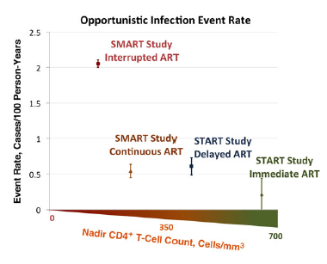
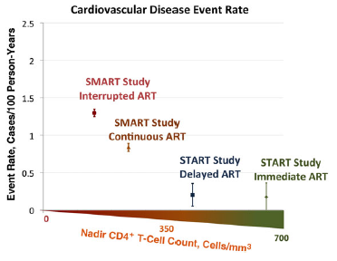
WHY DO SOME BUT NOT ALL INFLAMMATION ASSOCIATED MORBIDITIES DECLINE WITH EARLY ART INITIATION?
Incidence of opportunistic infections and cardiovascular events from SMART and START, according to the median pretherapy nadir CD4+ T-cell counts reported in each of the randomized groups from SMART and START Trials
Hunt et al. JID 2016

Slide 12
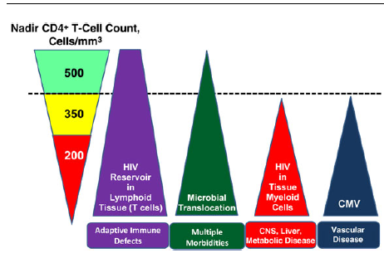
Why might some inflammation-associated diseases fail to develop during the duration of the START trial if a persistent inflammatory state is established within the first few weeks of HIV infection?
Theoretical model for the impact of nadir CD4+ T-cell count on the root drivers of immune activation in treated HIV infection and their disease manifestations. Several drivers of persistent immune activation despite ART–mediated viral suppression : HIV reservoirs in T cells and macrophages, microbial translocation, CMV coinfection…
Not all of them are active in pts who initiate ART at high nadir CD4+ T (ie, very early disease stages)
Many of them preferentially drive inflammation in distinct anatomic compartments.
→ root drivers of inflammation and disease manifestations induced by inflammation vary on the basis of nadir CD4+ T-cell count.
If such a model were true…
Systemic inflammatory markers in individuals with high nadir CD4+ T might predict infectious and neoplastic conditions but not necessarily CV, pulmonary, and neurocognitive morbidities.
Hunt et al. JID 2016
Notes:
Why might some inflammation-associated diseases fail to develop during the duration of the START trial if a persistent inflammatory state is established within the first few weeks of HIV infection?
One possibility is that a certain threshold of systemic inflammation is required to drive some end-organ diseases and that those who start ART very early achieve levels below this threshold.
we favor an alternative hypothesis related to the distinct putative drivers of immune activation during ART-mediated viral suppression, their relationship to the degree of pre-ART immunodeficiency (ie, nadir CD4+ T-cell count), and their anatomic localization (Figure 2).
Viral reservoirs in TCMcompartments, which are most abundant in inductive lymphoid tissues, are established within the first several days of systemic HIV infection, with an exponential increase in the first few weeks of infection followed by slower increases over the next few years. Once ART-mediated viral suppression is established, this primarily T-cell reservoir of HIV persists in lymphoid tissues and likely contributes to ongoing inflammation and lymphoid fibrosis, which may plausibly contribute to adaptive immune defects since these responses normally develop in the same anatomic compartment. Since immediate ART dramatically reduces HIV expression from T-cell reservoirs in lymphoid tissues, it is plausible that this mechanism explains why immediate ART reduced infectious and cancer events in the START and TEMPRANO trials. Conversely, the fact that immediate receipt of ART, even in recently infected individuals, fails to eliminate T-cell reservoirs of HIV in lymphoid tissues may explain the persistently high incidence of infectious and neoplastic complications (relative to those seen in the general population) even among individuals in the immediate ART arms of both the START and TEMPRANO trials.
Other persistent drivers of the inflammatory state during treated HIV infection may require more-significant pre-ART immunodeficiency to be irreversibly established. For example, while some markers of microbial translocation are evident in plasma within the first few weeks of HIV infection, the degree to which these defects become irreversible after ART-mediated viral suppression is greater with more-advanced disease. While translocated microbial products are concentrated in the liver and mesenteric lymphoid tissues, they are distributed widely throughout the circulation, so this driver of the systemic inflammatory state may plausibly contribute to several end-organ diseases, including cardiovascular complications, particularly in individuals with lower nadir CD4+ T-cell counts. Other potential drivers of the inflammatory state may require significant pre-ART immunodeficiency to be established and have distinct anatomic localization. For example, myeloid reservoirs of HIV in tissues (eg, brain microglia, adipose tissue, and liver), if they do persist during suppressive ART, might not be established to a clinically meaningful extent until later stages of untreated HIV infection because it appears to take some degree of CD4+ T-cell depletion for the virus to evolve the capacity to efficiently infect myeloid cells. This might explain why irreversible neurocognitive dysfunction, which is thought to be driven in part by direct HIV infection of central nervous system myeloid cells, appears to be much less common in individuals who initiate ART at high nadir CD4+ T-cell counts. Myeloid reservoirs of HIV in fat and liver might also plausibly contribute to metabolic disease and liver fibrosis in individuals with low nadir CD4+ T-cell counts.
Similarly, asymptomatic CMV replication, which has been proposed to be a mediator of vascular disease in HIV-infected individuals, particularly since it replicates in the vascular endothelium, may require a certain degree of immunodeficiency to establish sufficient CMV reservoirs in myeloid precursors or CMV-specific adaptive immune defects to drive cardiovascular disease.
Thus, not all putative root drivers of the inflammatory state in treated HIV infection are likely to be active in individuals who initiate ART at early disease stages.
While this model might explain why individuals initiating ART during early disease stages may prevent the establishment of certain (eg, cardiovascular, neurocognitive, and pulmonary) morbidities but still have a measurably increased risk of infectious and neoplastic morbidities as compared to the general population, it may also inform the interpretation of systemic immune activation and inflammatory markers.
if one measures levels of systemic immune activation markers in HIV-infected individuals with high nadir CD4+ T-cell counts (ie, those above the dotted line in Figure 2), the primary source of any measured abnormalities is likely to be HIV reservoirs in lymphoid tissues and, potentially, microbial translocation.
when one measures systemic immune activation and inflammatory markers in HIV-infected individuals with very low nadir CD4+ T-cell counts, a much greater diversity of sources and anatomic sites likely contributes to any elevations observed.
If such a model were true, one would expect that systemic inflammatory markers measured in individuals with high nadir CD4+ T-cell counts might predict infectious and neoplastic conditions but not necessarily CV, pulmonary, and neurocognitive morbidities.
Conversely, systemic inflammatory markers measured in individuals with low nadir CD4+ T-cell counts might predict all of these morbidities of interest. While no biomarker studies to date have had sufficient numbers of clinical events among participants with high nadir CD4+ T-cell counts to address these hypotheses, this could be explored in future studies.

Slide 13
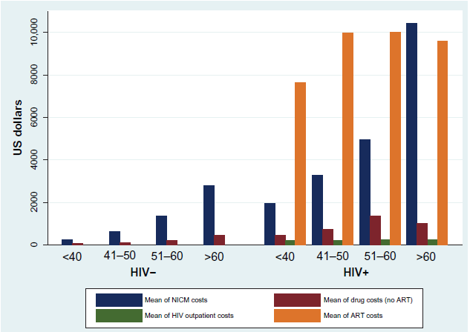
Cost of noninfectious comorbidities in patients with HIV
ARV cost
2005-2006: 10-40K$ / an
Comorbidities cost
+1 comorbidité: +7K$ /an
+3 comorbidités: +32K$ / an
Cost of noninfectious comorbiditiesin patients with HIV. Giovanni Guaraldi et al. ClinicoEconomics and Outcomes Research 2013

Slide 14
Chronic health conditions in Medicare beneficiaries 65 years and older with HIV infection.
2011: 36% >50 years (35000 patients > 65 ans)
2020: 50% > 50 years
Older PLWHIV experience age-related illnesses earlier in life, or in a more severe form than their non-HIV infected
Hypothesize : the greater severity and earlier onset of these diseases may be due to:
Changes in immunity and inflammation caused by HIV infection.
HAART : damage to the kidneys and liver, interaction drug toxicity-age-related declines in organ function (association with abnormal lipid profiles, which can increase the risk of cardiovascular diseases and diabetes)
PLWHIV are more prone to age related chronic diseases due to high prevalence of harmful behaviors, such as substance abuse.
Friedman et al. AIDS Accepted
Notes:
Objectives: to examine sociodemographic factors and chronic health conditions of people living with
HIV (PLWHIV/ HIV+) >65 years, and to compare their chronic disease prevalence to beneficiaries
without HIV.
Design: National fee for service (FFS) Medicare claims data (parts A and B) from 2006-2009 were used
to create a retrospective cohort of beneficiaries >65 years old.
Methods: Beneficiaries with 1 inpatient or skilled nursing facility claim, or 2 outpatient claims with HIV
diagnosis codes were considered HIV+. HIV+ beneficiaries were compared to uninfected beneficiaries
on demographic factors and on the prevalence of hypertension, hyperlipidemia, ischemic heart disease,
rheumatoid arthritis/osteoarthritis, and diabetes. Odds ratios (OR), 95% confidence intervals (CI), and pvalues
were calculated. Adjustment variables included age, sex, race/ethnicity, end stage renal disease
(ESRD), and dual Medicare-Medicaid enrollment. Chronic conditions were examined individually, and
as an index from zero to all five conditions.
Results: Of 29,060,418 eligible beneficiaries, 24,735 (0.09%) were HIV+. HIV+ beneficiaries were
more likely to be Hispanic, African American, male, and younger (p>0.0001), and were 1.5 to 2.1 times
as likely to have a chronic disease (diabetes (aOR) 1.51 95% CI (1.47, 1.55): rheumatoid
arthritis/osteoarthritis 2.14 95% CI (2.08, 2.19)), and 2.4 to 7 times as likely to have 1-5 co-morbid
chronic conditions (1 condition (aOR) 2.38 95% CI (2.21, 2.57): 5 conditions 7.07 95% CI (6.61, 7.56)).
Conclusions: Our results show that PLWHIV >65 years are at higher risk of comorbidities than other
FFS Medicare beneficiaries. This finding has implications for both the management and cost of the
health of PLWHIV ≥65.

Slide 15
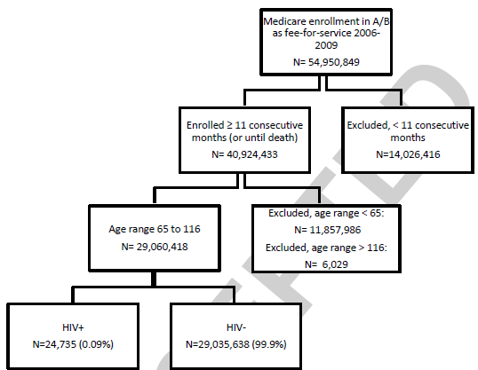
Chronic health conditions in Medicare beneficiaries 65 years and older with HIV infection. E. E. FRIEDMAN, W. A. DUFFUS. Office of Health Equity, National Center for HIV/AIDS, Viral Hepatitis, STD, and TB Prevention, Centers for Disease Control and Prevention . AIDS, accepted
Objectives: to examine sociodemographic factors and chronic health conditions of PLWHIV >65 years, and to compare their chronic disease prevalence (hypertension, hyperlipidemia, ischemic heart disease, rheumatoid arthritis/osteoarthritis, and diabetes) to beneficiaries without HIV.
Design: National fee for service (FFS) Medicare claims data from 2006-2009: retrospective cohort of beneficiaries >65 years old.
(Medicare : > 65 ans et ESRD
Medicaid: seuil de pauvreté)
Notes:
Objectives: to examine sociodemographic factors and chronic health conditions of people living with
HIV (PLWHIV/ HIV+) >65 years, and to compare their chronic disease prevalence to beneficiaries
without HIV.
Design: National fee for service (FFS) Medicare claims data (parts A and B) from 2006-2009 were used
to create a retrospective cohort of beneficiaries >65 years old.
Methods: Beneficiaries with 1 inpatient or skilled nursing facility claim, or 2 outpatient claims with HIV
diagnosis codes were considered HIV+. HIV+ beneficiaries were compared to uninfected beneficiaries
on demographic factors and on the prevalence of hypertension, hyperlipidemia, ischemic heart disease,
rheumatoid arthritis/osteoarthritis, and diabetes. Odds ratios (OR), 95% confidence intervals (CI), and pvalues
were calculated. Adjustment variables included age, sex, race/ethnicity, end stage renal disease
(ESRD), and dual Medicare-Medicaid enrollment. Chronic conditions were examined individually, and
as an index from zero to all five conditions.
Results: Of 29,060,418 eligible beneficiaries, 24,735 (0.09%) were HIV+. HIV+ beneficiaries were
more likely to be Hispanic, African American, male, and younger (p>0.0001), and were 1.5 to 2.1 times
as likely to have a chronic disease (diabetes (aOR) 1.51 95% CI (1.47, 1.55): rheumatoid
arthritis/osteoarthritis 2.14 95% CI (2.08, 2.19)), and 2.4 to 7 times as likely to have 1-5 co-morbid
chronic conditions (1 condition (aOR) 2.38 95% CI (2.21, 2.57): 5 conditions 7.07 95% CI (6.61, 7.56)).
Conclusions: Our results show that PLWHIV >65 years are at higher risk of comorbidities than other
FFS Medicare beneficiaries. This finding has implications for both the management and cost of the
health of PLWHIV ≥65.

Slide 16
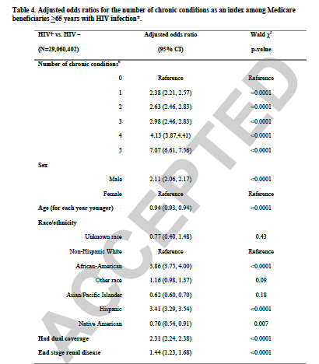
HIV+ beneficiaries were more likely to be
Hispanic, African American,
Male
younger (71 vs 75y.)
to have 1-5 co-morbid chronic conditions
ARV cost
2005-2006: 10-40K$ / an
Comorbidities cost
+1 comorbidité: +7K$ /an
+3 comorbidités: +32K$ / an
Friedman et al. AIDS Accepted
Notes:
As
greater numbers of PLWHIV enter Medicare as age-eligible beneficiaries, the majority of their care
costs will shift from Medicaid to Medicare (27). This is important given that costs for HIV care are
considerable, even without the additional costs seen when multiple chronic conditions are also
considered. Cost estimates of living with HIV in the U.S. range considerably depending on demographic
and HIV related factors; but estimates using 2005 and 2006 data range from $10,000 to $40,000 per year
(28, 29). Costs associated with multiple chronic health problems are also high. Data from 2005 Medicare
expenditure costs, indicate that the annual costs for Medicare beneficiaries with one chronic condition
are $7,172, and for beneficiaries with three or more chronic conditions $32,498 (30 ).
This is the first and largest study to the authors’ knowledge to examine chronic conditions
among PLWHIV who are exclusively >65 years of age. Previous studies have examined frequencies of
chronic conditions among PLWHIV >50 years but few of these studies have included large numbers of
participants 65 years and older (33-37). This study is in agreement with many previous studies that have
found higher prevalence of disease, or increased risk for cardiovascular diseases, arthritis, and diabetes
among persons with HIV, both among those >50 years of age and those not focused on older persons
with HIV (7, 11, 38).
In conclusion this is the first and largest study of PLWHIV >65 years old. Using an original data
source, our results show that this population is at significantly higher risk of comorbidities than other
non-HIV infected Medicare beneficiaries. Medicare data represent a rich source of information to create
HIV-positive cohorts with information on multiple chronic conditions that affect older PLWHIV

Slide 17
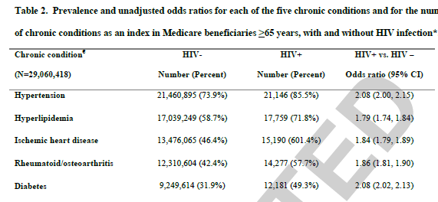
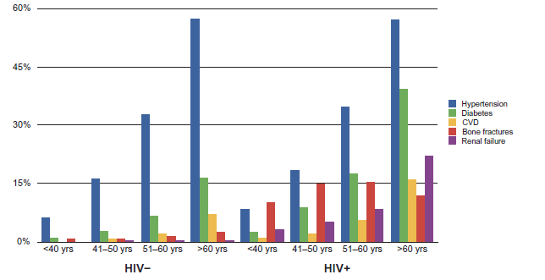
PLWHIV >65 years are at higher risk of comorbidities than other FFS Medicare beneficiaries.
→implications for both the management and cost of the health of PLWHIV ≥65.
Giovanni Guaraldi et al. ClinicoEconomics and Outcomes Research 2013
Friedman et al. AIDS Accepted

Slide 18
Researchers Confront an Epidemic of Loneliness By KATIE HAFNER SEPT. 5, 2016

